Slide 1
Modeling tokens on Blockchain (IBM) Final presentation 234313
Naomie Abecassis
David Valensi
Tutors:
Dany Moshkovich
Artem Barger

Slide 2
Goals
Throughout the project we:
Learned Blockchain basics
Got familiar with the Blockchain Ethereum test network
Got familiar with solidity object-oriented language
Got familiar with ganache test environment
Implemented different version of ownership and rental assets using smart contracts in 3 steps
Implemented a dynamic dependency between tokens

Slide 3
Goals #2
The blockchain is a static environment where, once a contract is deployed, the code is immutable.
This project aims to show an extension mechanism such that current functionalities are extended in the future, with the owner agreement.

Slide 4
Methodology
The goal of this project is to explore ways to implement dynamic inter-dependency between tokens
We apply that to ownership and rental assets
We implemented the following steps:
First step: no dependency
Second step: static dependency
Third step: dynamic dependency

Slide 5

Achievements
First, we implemented ownership token and rental token independent one of the other
Ownership Token
Rental Token
No dependency

Slide 6
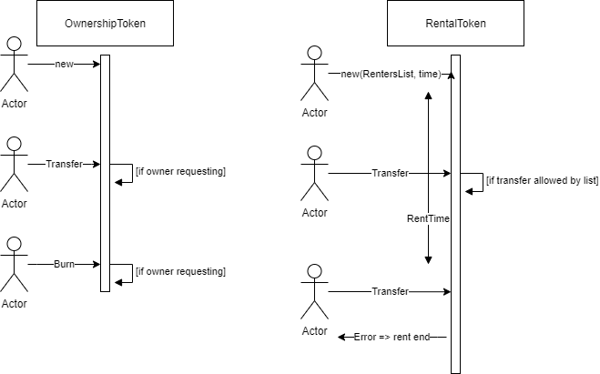
First step sequence diagram

Slide 7
Second step: static dependency
Then, we introduced static dependency between the contracts
Ownership Token
Rental Token
Static dependency
Creates, uses…

Slide 8
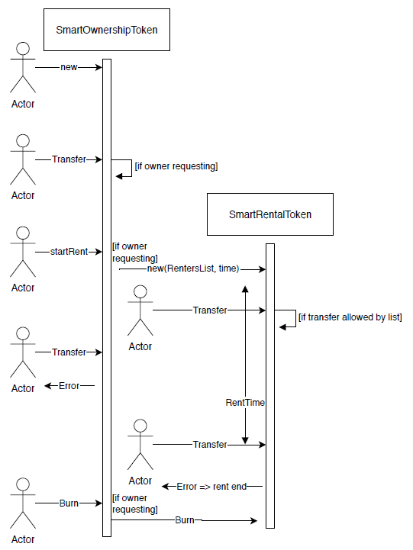
Second step sequence diagram

Slide 9
Third step: dynamic dependency
Finally we updated the dependency to be dynamic, we can now add new extensions to the contracts
Ownership Token
Extension Token
Rental Token
Add
Creates, uses…

Slide 10
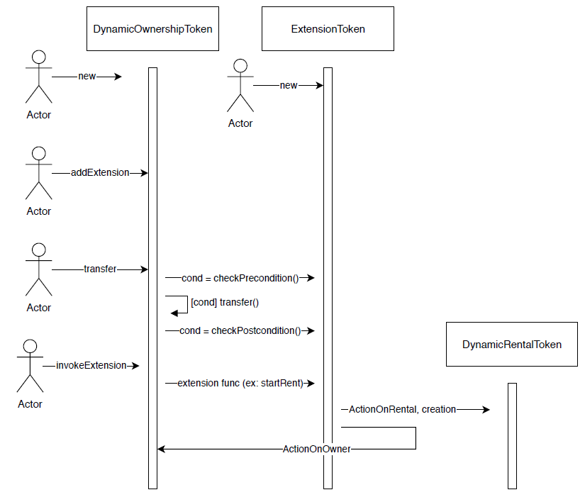
third step sequence diagram

Slide 11
Example
Compile and deploy the code of DynamicOwnership and DynamicRental tokens
=> Independent one of the other
Compile and deploy the extension token
Instantiate a DynamicRental token thanks to this extension, and handle actions on it
Write a new code for an extension, for example an option for renting the object
Add this new extension to the existing DynamicOwnership token
Add more conditions to the actions done on the Ownership token

Slide 12
Concret Example with a car
Let’s show an example of a scenario from the reality:
David is the owner of a car and creates a DynamicOwnership token for his car
Only him can sell (transfer) the car as he wants
He decides to add rent on the car by adding the extension provided in this project
David makes a rent to Dany and Artem for a week
After that, let’s say David want to add an option to this car for painting the car in a new color: David writes the code and the new conditions that it needs
He then deploys the code and add this extension to the token of his car
Now we can start a process of painting the car
And in order to sell the car we must first check that the car is not in a process of painting
In this project we developed a strong tool to add library styles functions and options on an existing contract

Slide 13
Shared memory for extensions
Our mechanism allows each extension to add memory variables to the data map of Ownership token.
We can implement inter-extension dependency if we have a priori knowledge of other extensions
For example we can set a rule that forbids painting the car during a valid rent of the car
However the extended contract must trust the extensions and their memory interactions

Slide 14
Conclusion
The final implementation supports the requirements that were given at the beginning of the project
However there are some limitations:
The extension token must contain the same state variables as the extended contract (including his parents)
When invoking an extension the errors thrown don’t bubble up

Slide 15
Thank you

